Slide 1

MINI PROJECT
TRASH CLASSIFICATION USING MACHINE LEARNING
GUIDE:
Dr.G.SARITHA(ASSOCIATE PROFESSOR)
GROUP:
CH.VARSHITH(160722733028)
V.HARSHITH(160722733027)
S.OMKAR(160722733032)

Slide 2

Introduction
Trash Classification Using Machine Learning
With the growing concern over environmental pollution and the need for efficient waste management, automating the process of trash classification has become increasingly important. This project leverages Artificial Intelligence (AI) and Deep Learning to build a system that can accurately classify images of waste into categories such as cardboard, glass, metal, paper, plastic, and general trash.
Using a Convolutional Neural Network (CNN) trained on the TrashNet dataset, the model learns to recognize visual features of different waste materials. This enables faster and more reliable sorting of recyclable and non-recyclable items, which can significantly enhance recycling processes and reduce manual labor.

Slide 3
Pre Existing Technology
Google Cloud AutoML Vision: Offers powerful pre-trained models but requires extensive data and is not cost-effective for all users.
Bin-e (Smart Bin): Uses sensors and AI to identify and sort waste, but it is hardware-intensive and expensive.
TrashBot: Another smart bin solution that recognizes recyclable and non-recyclable items.
Limitations: These systems are costly, not open-source, and lack customization for localized use-cases.

Slide 4
Problem Statement
Current waste segregation methods are predominantly manual, time-consuming, and highly prone to human error.These inefficiencies contribute to the contamination of recyclable materials, increased landfill usage, and inflated waste processing costs.
Existing smart waste systems are either too costly or limited in scalability and flexibility.Hence, there is a pressing need for an accurate, affordable, and scalable image-based classification solution that can support waste management efforts in both residential and industrial settings.

Slide 5
Proposed System
Our system features a custom-designed Convolutional Neural Network (CNN) tailored to the six-class classification problem.
It is trained on the TrashNet dataset, which includes labeled images of cardboard, glass, metal, paper, plastic, and general trash.
Designed to be lightweight and resource-efficient, the model runs effectively even on standard CPUs—making it ideal for low-resource environments.
The system is integrated into a user-friendly Streamlit web application, enabling users to simply drag and drop trash images for instant classification.
The streamlined pipeline ensures quick predictions, making it practical for educational, municipal, and household applications.

Slide 6
Literature Survey
S. No | Study / Work | Description | Key Takeaways
1 | TrashNet Dataset (Gary Thung & Mindy Yang, 2017) | Introduced a dataset with images of different waste types like cardboard, glass, metal, paper, plastic, and trash. Widely used in early waste classification projects. | A standard dataset that helps train and evaluate waste classification models. Simple but effective.
2 | CNNs for Waste Classification (Krizhevsky et al., 2012) | Convolutional Neural Networks have proven highly effective in image-related tasks. In waste sorting, CNNs automatically learn visual features like shape and texture. | CNNs are powerful for identifying and classifying waste from images without manual feature design.
3 | Transfer Learning Approaches (Pan & Yang, 2010) | Pre-trained models like ResNet or VGG can be reused for waste classification, especially when the dataset is small. Only the last few layers are retrained. | Saves time, improves accuracy, and works well even if you don't have tons of data.
4 | Smart Waste Sorting Bins (IoT + DL) (Sudharsan & Muthusamy, 2021) | Combines deep learning with IoT devices (like smart bins) to classify waste in real time using camera input and edge computing. | Brings automation to real-world waste management systems. Helps reduce manual sorting.
5 | Modern Trends & Issues (Raza et al., 2019) | Discusses common challenges like unbalanced datasets and mixed waste types. Also explores ideas like using GANs to generate more data. | Data imbalance is a major issue. Newer solutions like synthetic data and multi-label models are emerging.

Slide 7
Objective
⚙️ Automate Waste Classification Using Deep Learning Develop a Convolutional Neural Network (CNN) capable of identifying and classifying various types of waste based on image input, eliminating the need for manual sorting.
🎯 Enhance Sorting Accuracy and Consistency Reduce human error and variability by ensuring the model consistently recognizes and categorizes waste into predefined classes: cardboard, glass, metal, paper, plastic, and general trash.
🖥️ Develop a User-Friendly Interface Build a simple yet effective web application using Streamlit that allows users to easily upload images of trash and receive real-time predictions with confidence scores.
♻️ Enable Real-World Integration Lay the technological foundation for integration into smart bins, waste management mobile apps, and municipal recycling systems to promote sustainable waste handling practices.

Slide 8
Proposed Architecture
The architecture is a custom-designed Convolutional Neural Network (CNN) optimized for classifying images into six trash categories. It begins with an input layer accepting 224x224 RGB images. The model then passes the image through multiple convolutional layers activated by ReLU functions to extract features like edges and textures. These are followed by MaxPooling layers to reduce spatial dimensions and highlight dominant features.
After convolution, the feature maps are flattened and passed into dense (fully connected) layers that learn class-specific patterns. A Dropout layer is used to prevent overfitting by randomly deactivating neurons during training. Finally, the output layer uses a Softmax activation to predict the probability of the image belonging to one of the six classes.
Input: 224x224 RGB image
Conv Layer 1 + ReLU + MaxPooling
Conv Layer 2 + ReLU + MaxPooling
Conv Layer 3
Flatten → Dense Layer → Dropout
Output Layer (Softmax for 6 classes)
Optimizer: Adam
Loss Function: Sparse Categorical Crossentropy

Slide 9
Dataset
This model is trained on the well-known TrashNet dataset provided by Stanford University. It contains labeled images categorized into six types of waste. The images are preprocessed to match the model input requirements and to enhance learning efficiency.
Dataset Name: TrashNet
Source: Stanford University
Categories: Cardboard, Glass, Metal, Paper, Plastic, Trash
Total Images: ~2,500
Image Size: 224x224
Data Split: 70% Training / 15% Validation / 15% Test
Preprocessing Steps: Resizing, Normalization, Data Augmentation (flip, rotate, zoom)

Slide 10
Model Compilation & Training
The model is compiled with the Adam optimizer, ideal for deep learning due to its adaptive learning rates. Sparse Categorical Crossentropy is used to measure prediction errors on integer-labeled data.
Optimizer: Adam
Loss Function: Sparse Categorical Crossentropy
Batch Size: 32
Epochs: 8
Achieved Accuracy: ~85% on validation set

Slide 11
Challenges & Enhancements
Due to a relatively small dataset, the model initially suffered from overfitting. This was addressed with data augmentation techniques.
For future iterations, integrating transfer learning from pre-trained models like MobileNet or VGG16 is recommended to boost accuracy and reduce training time.
Challenge: Overfitting on small dataset
Solution: Data augmentation (rotation, flipping)
Future Work: Transfer learning, Ensemble models

Slide 12
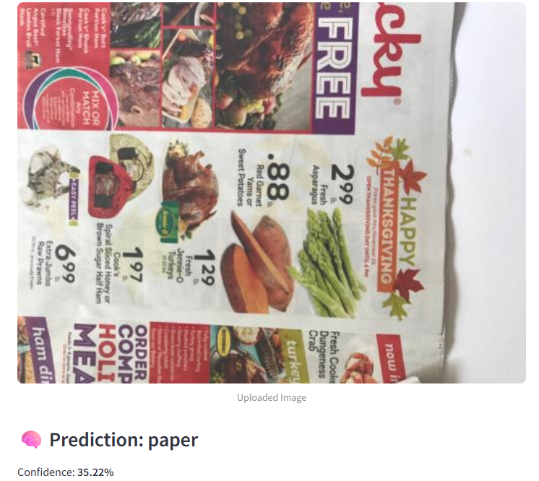
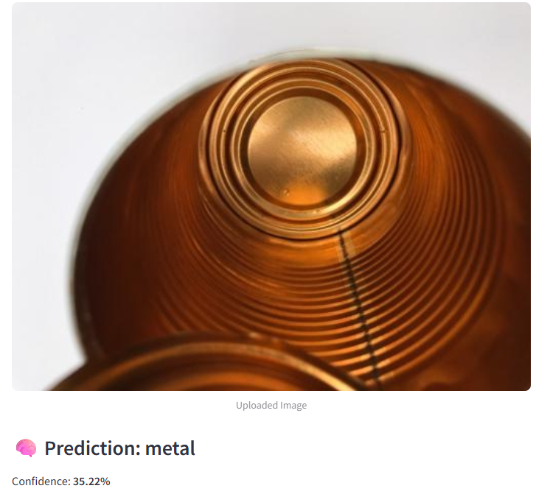
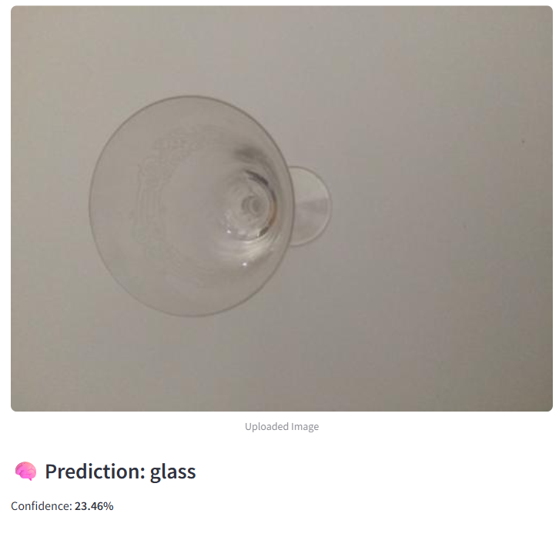
Output
The final model is integrated into a Streamlit web application where users can upload an image of trash. The image is processed in real-time, and the system outputs the predicted category with a confidence score. This intuitive interface makes the tool accessible and easy to use for everyone.

Slide 13
Conclusion
This project successfully demonstrates how deep learning can automate and enhance waste classification. With a custom CNN and an interactive web interface, it bridges the gap between complex AI systems and real-world usability. The lightweight model can operate in low-resource settings and has significant potential for scaling.
Achieved automatic classification of six trash categories
Developed a clean and easy-to-use Streamlit web app
Accuracy and performance suited for practical use
Future Plans: Real-time deployment, IoT/hardware integration, and support for more waste types

Slide 14
References
O’Shea, Keiron, and Ryan Nash. “An Introduction to Convolutional Neural Networks.”
arXiv:1511.08458
Smart Waste Management Systems
CleanRobotics: https://cleanrobotics.com/
Bin-e: https://bine.world/
TrashNet Dataset
H. Yang and P. Thung, “TrashNet: A Dataset for Image-based Garbage Classification,” Stanford University
https://github.com/garythung/trashnet
TensorFlow Documentation
Deep learning model building and training
https://www.tensorflow.org/

Slide 15
THANK YOU

